Slide 1

Video Volunteers - India
Viz For Social Good

Slide 2
Ideas for the Project
I unfurtunately had less time on my hands than anticipated and thus I couldn’t follow up on pouring some of my ideas for the project into an actual dashboard. However I want to take the chance to at least outline some of them here briefly, so others might have the chance to incorporate whatever seems useful.
Welcoming / guiding Avatar
AI-guided breakdown of the description column
Wordcloud
Map from Geodata on states
Thumbnail generator from url column
Most work presented has been done in python, scripts/content are available on GitHub. Please feel free to contact me via dennis.schuette@osnanet.de or on the slack channel in case of any questions.

Slide 3





Welcoming / guiding Avatar
gernerative AI-Tools can be used to generate picture from text and subsequently animate those pictures by combining them with a custom text. Thus it’s possible to create any avatar with low effort that could be used to welcome guests on the website / dashboard, arise interest and guide through content
play message

Slide 4
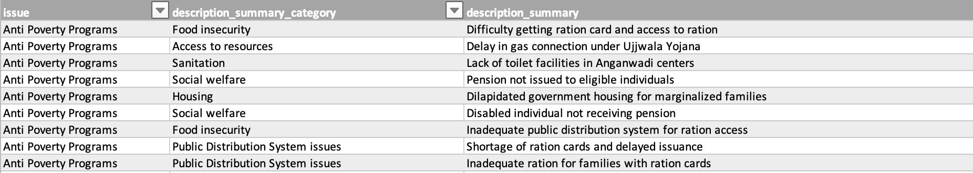
AI-guided breakdown of the description column
AI-tools like ChatGPT have the ability to process and summarize large amounts of texts. A summary approach has been tested on the description column of the data, allowing to drill down into the content, classify issues with higher granularity and make it more digestiable overal.
Used Prompt
Provide a table with two columns. Column one shall contain a summary of the following text with each row representing a bullet. Column two shall contain the category that the described issue in column one falls into: <description>
ChatGPT output
ChatGPT output

Slide 5
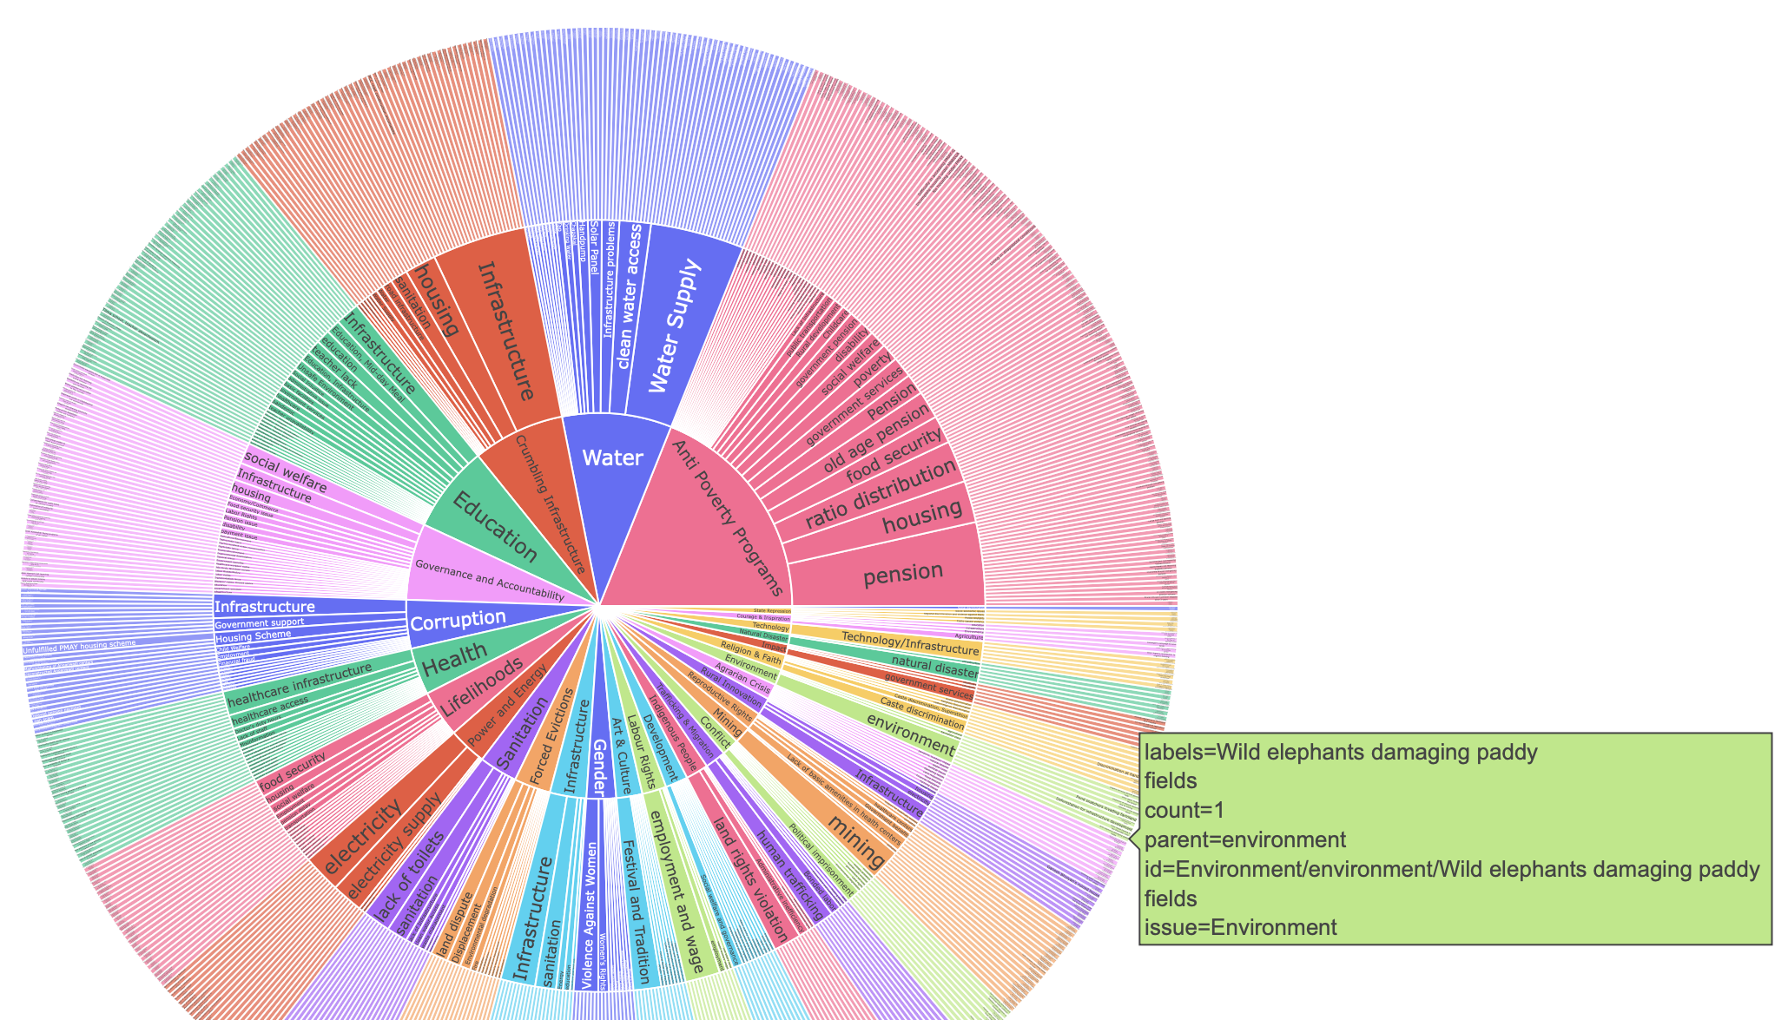
AI-guided breakdown of the description column
…
categories from issue column
AI-generated sub-categories
AI-generated summary

Slide 6
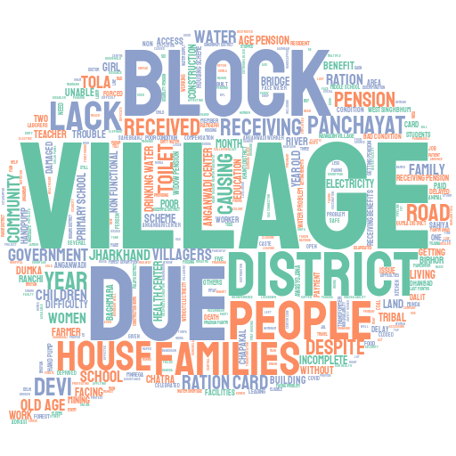

Wordcloud
creating a wordcloud from descriptions, categories or summarized texts to potentially give a first impression on the most wide spread issues at hand

Slide 7
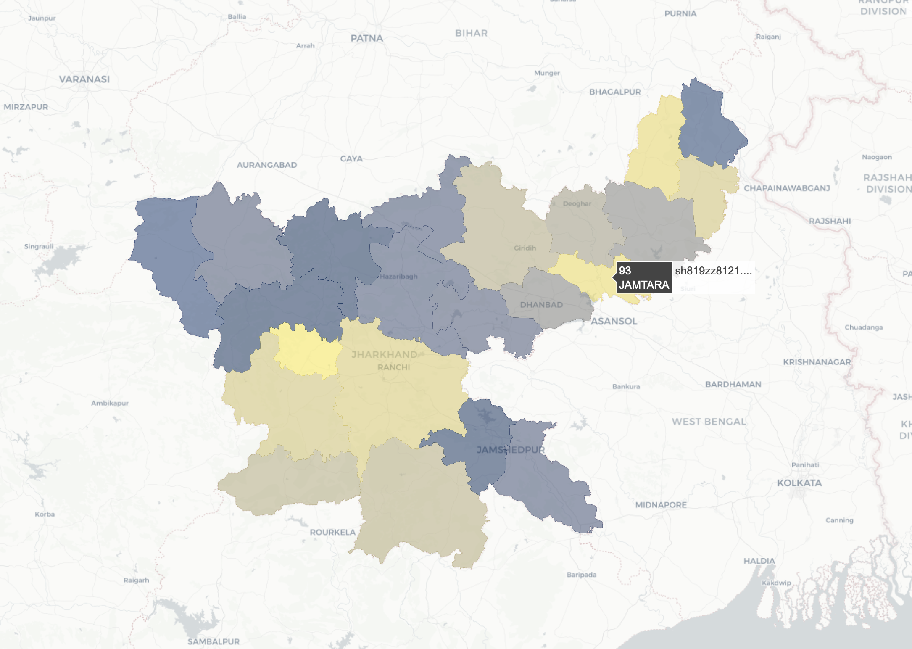
Map from Geodata on states
The geographic location adds up valuable context on where most issues arise, which categories affect which regions and where a political response has been archieved. Since the names of small villages is often not reliably available on mapping services, the spatial resolution of states has been targeted here, making use of publical available geodata (see below) that can be matched with the state name column
geodata-source: https://geodata.mit.edu/catalog/ stanford-sh819zz8121

Slide 8

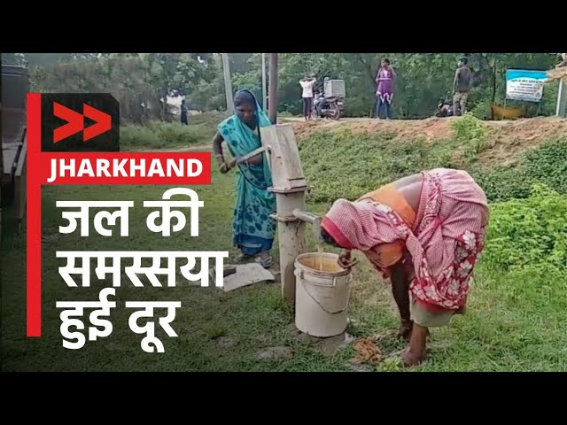
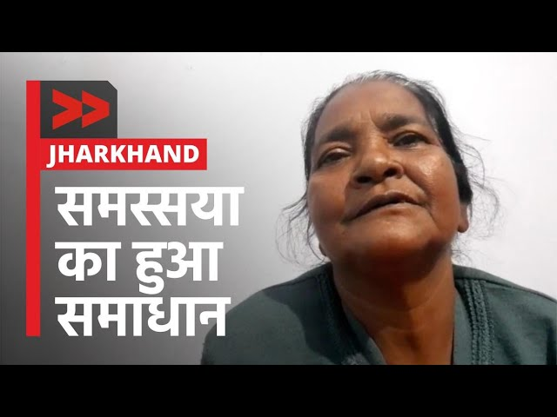
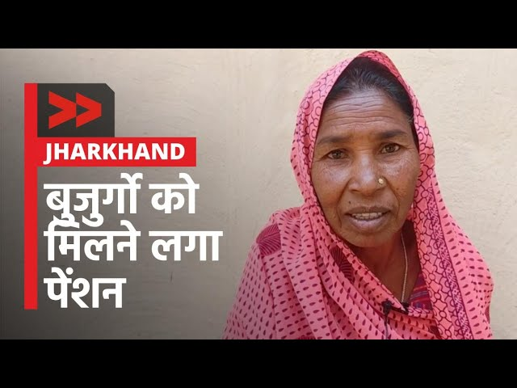
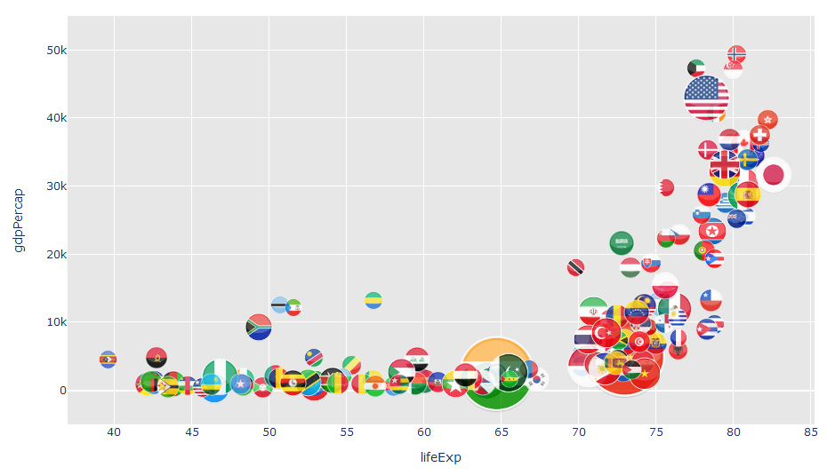
Thumbnail generator from url
Video thumbnails could be used to to give a first impression on the story, e.g. when a specific case is selected or to create a visually attractive map similar to the one on the right, with thumbnails instead of country flags. A python script has been written that extracts the thumbnails from all videos, making use of the provided urls. They could optionally be transformed to represent a circular form.

